Slide 1

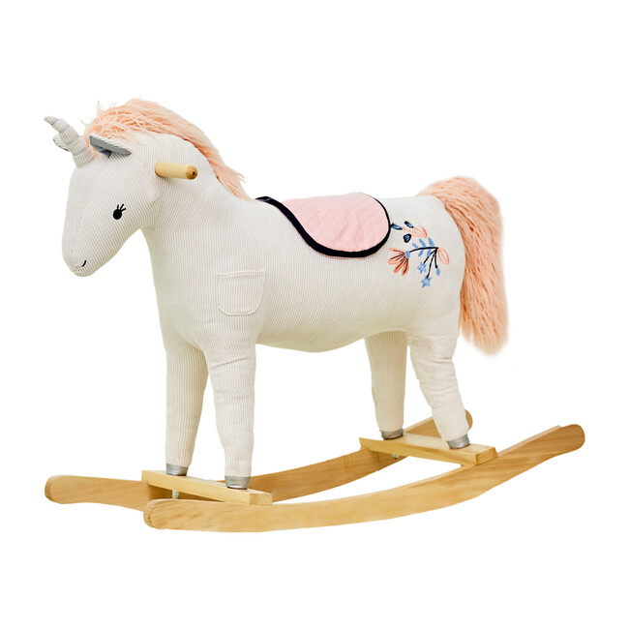
Toy Horse
Conjoint Analysis for EarlyRiders
GBA 424 11B
Dec 7th, 2020
MSBA Online Team B:
Emma Lin, Vedant Vashishth
Vivian Chen, Yuqi Sun, Yuzhou Lu

Slide 2
Introduction
Implement low price strategy
Replace current products by 2 new products
Conjoint model
Benefit Segmentation analysis
Market simulations
Summary & Recommendation
Overview

Slide 3
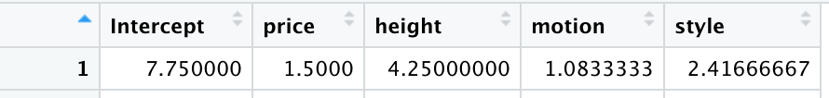
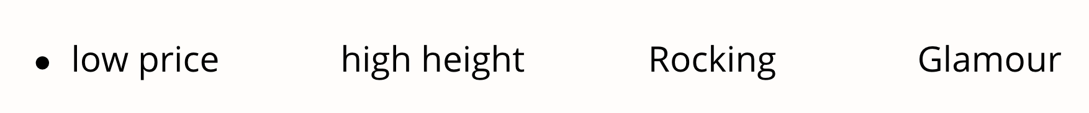





Individual Level Part- Utilities
200 individual data
predict individual performances
predict for missing profile
price height(0) motion(0) style(0)

Slide 4
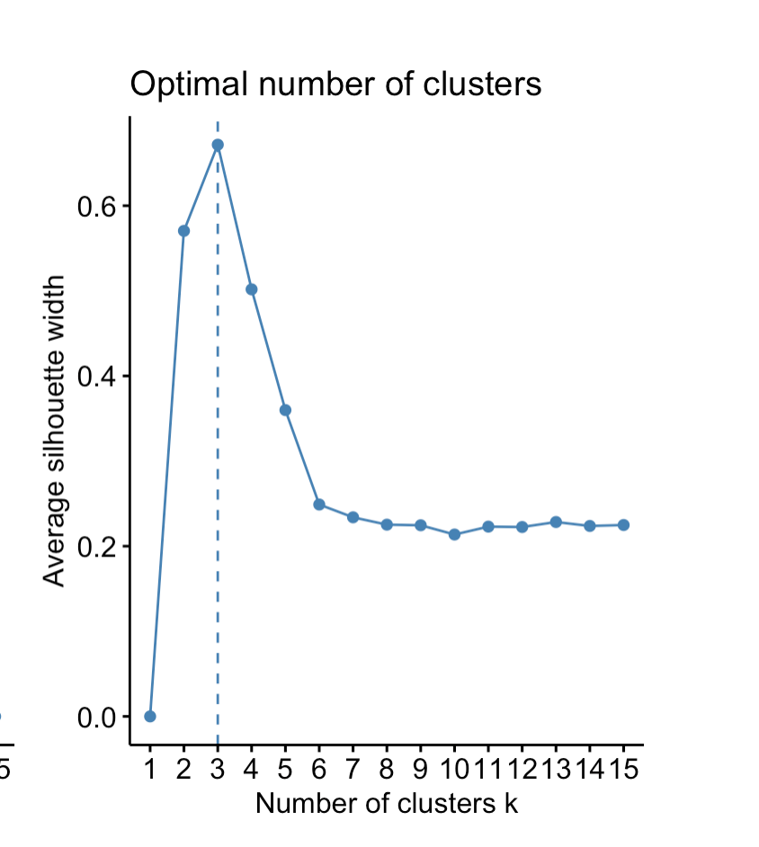
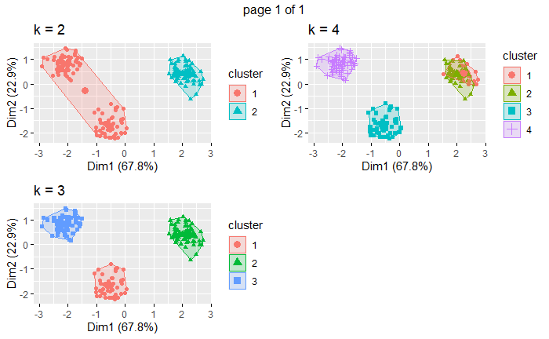
Divide Into Three Distinct Segments
Using K-means clustering analysis to find out the customer groups share the same characteristics.

Slide 5
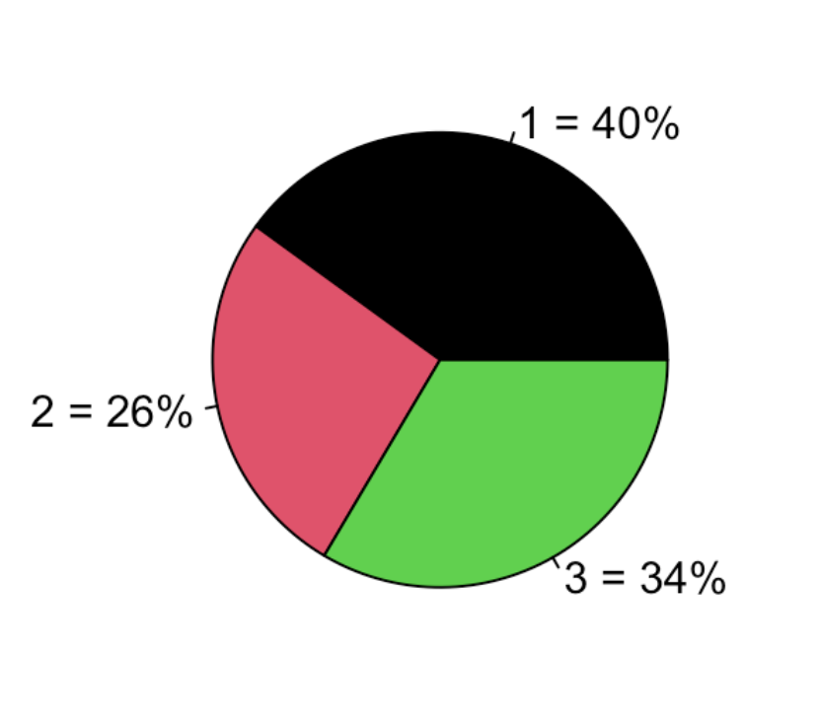
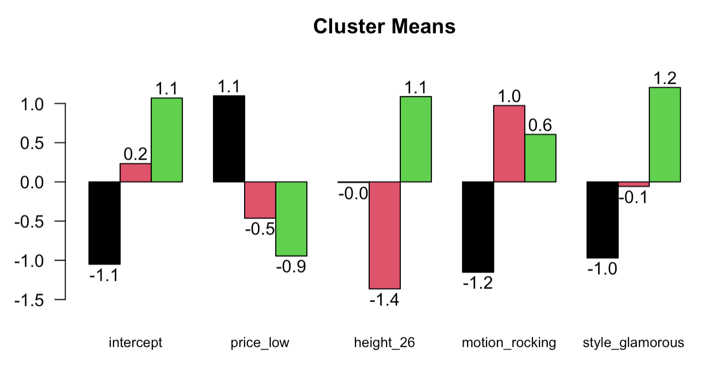
The Largest Cluster Prefers Low Price
The Ideal Product for Each Cluster
Cluster | Price | Height | Motion | Style | Ideal Product
1 (40%) | Low price | 26 inches | Bouncing | Racing | 4
3 (34%) | Low price | 26 inches | Rocking | Glamorous | 16
2 (26%) | Low price | 18 inches | Rocking | Glamorous | 14

Slide 6
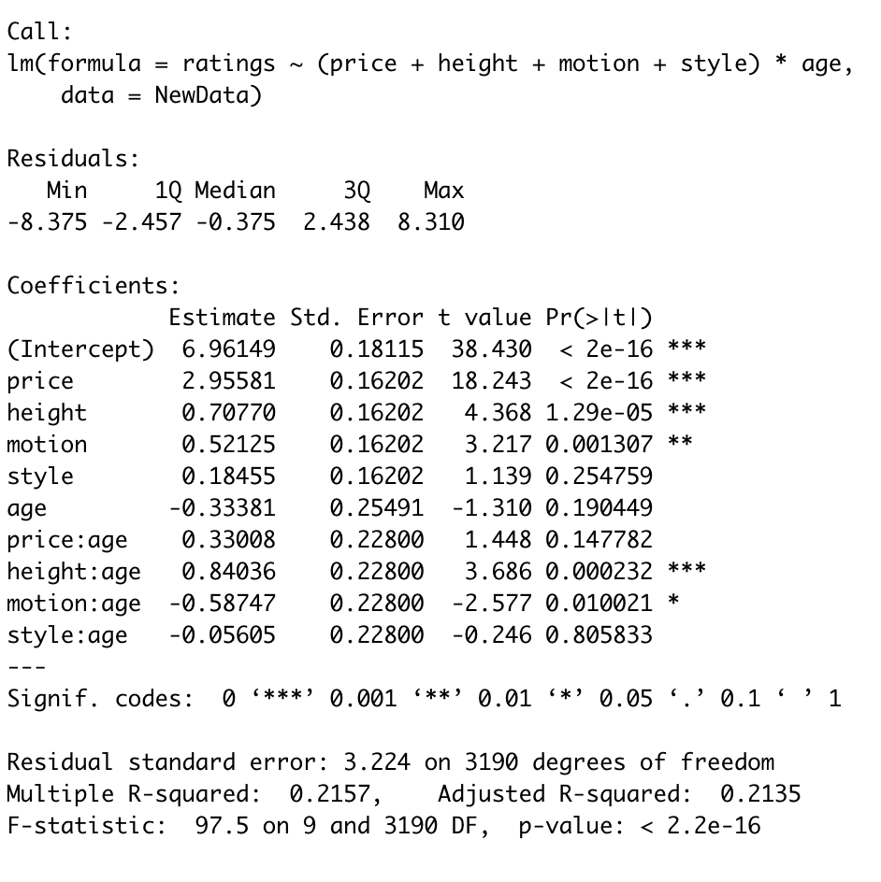
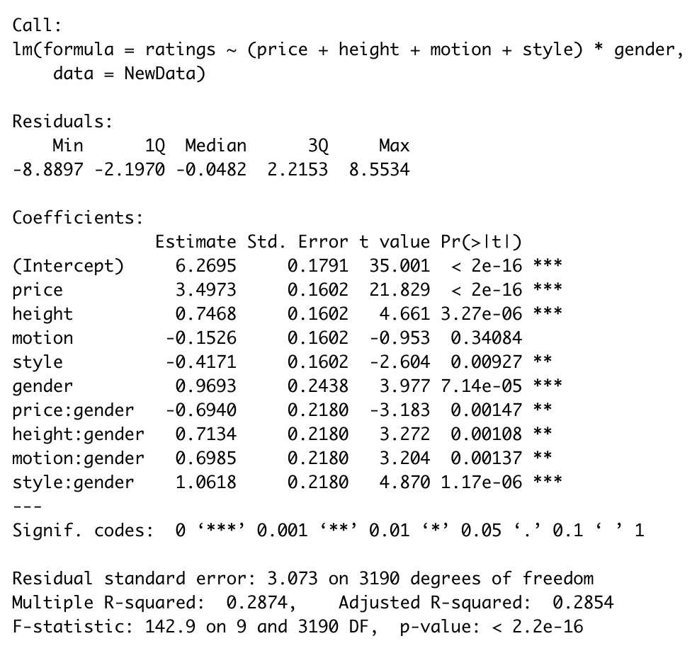


Benefit Segmentation (Priori Segmentation)
Age affects height and motion

Slide 7
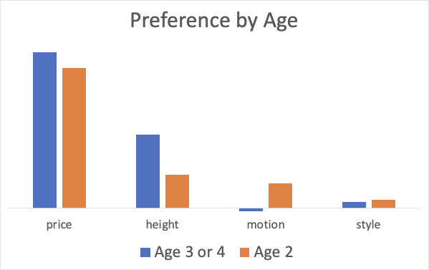
Priori Segmentation -- Age
Parents with older kid prefer rocking toys while parents with younger kid prefer bouncing toys
They all prefer low-price & larger size toy, especially parents with older kids
Parents with older kids are more price sensitive
Age | Price | Height | Motion | Style | Ideal Product
Age 3 or 4 | Low Price | 26 inches | Bouncing | Glamorous | 12
Age 2 | Low Price | 26 inches | Rocking | Glamorous | 16

Slide 8
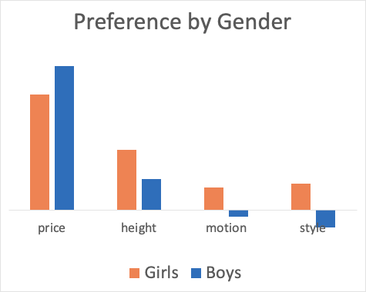
Priori Segmentation -- Gender
Boys' parents more price sensitive; they prefer bouncing & racing toys
Girls’ parents prefer rocking & glamorous toys
Gender | Price | Height | Motion | Style | Ideal Product
Girl | Low Price | 26 inches | Rocking | Glamorous | 16
Boy | Low Price | 26 inches | Bouncing | Racing | 4

Slide 9
Market Simulations
Product Portfolio
Scenarios Justification
Costs & Profit Calculations

Slide 10
Product Portfolio
Profile | Price | Height | Motion | Style | Status
4 | Low Price | 26 inches | Bouncing | Racing | Ideal
12 | Low Price | 26 inches | Bouncing | Glamour | Ideal
14 | Low Price | 18 inches | Rocking | Glamour | Ideal
16 | Low Price | 26 inches | Rocking | Glamour | Ideal
13 | High Price | 18 inches | Rocking | Glamour | Existed
5 | High Price | 18 inches | Rocking | Racing | Existed
7 | High Price | 26 inches | Rocking | Racing | Existed Comp
8 | Low Price | 26 inches | Rocking | Racing | Potential Comp
* Once we launch new low-price products, the competitors will respond by lowering price (from profile 7 to 8).

Slide 11
Current
s1: 5,13,7
One Existing Product & One Ideal Product
s2: 13,4,8 ; s3: 13,12,8 ; s4: 13,14,8 ; s5: 13,16,8 ;
s6: 5,4,8 ; s7: 5,12,8 ; s8: 5,14,8 ; s9: 5,16,8 ;
Two Ideal Products
s10: 4,12,8; s11: 4,14,8; s12: 4,16,8;
s13: 12,14,8; s14: 12,16,8; s15: 14,16,8;
Scenarios Justification

Slide 12
Costs & Profit
 | P5 | P4 | P12 | P14 | P16 | P13 | P7 | P8 | mkt Share | First Year Profit | Second Year Profit
13 | NA | NA | 0.62 | 0.25 | NA | NA | NA | 0.13 | 0.87 | 230805.2 | 244805.2
12 | NA | 0.40 | NA | NA | 0.45 | NA | NA | 0.16 | 0.85 | 204906.2 | 218906.2
11 | NA | 0.46 | NA | 0.30 | NA | NA | NA | 0.25 | 0.76 | 191829.8 | 205829.8
10 | NA | 0.43 | 0.31 | NA | NA | NA | NA | 0.27 | 0.74 | 189990.6 | 203990.6
14 | NA | NA | 0.32 | NA | 0.45 | NA | NA | 0.23 | 0.77 | 180009.2 | 194009.2
3 | NA | NA | 0.63 | NA | NA | 0.09 | NA | 0.29 | 0.71 | 181891.6 | 188891.6
7 | 0.06 | NA | 0.63 | NA | NA | NA | NA | 0.31 | 0.69 | 177252.4 | 184252.4
15 | NA | NA | NA | 0.25 | 0.38 | NA | NA | 0.38 | 0.63 | 131315 | 145315
2 | NA | 0.47 | NA | NA | NA | 0.09 | NA | 0.45 | 0.56 | 130037.8 | 137037.8
6 | 0.07 | 0.48 | NA | NA | NA | NA | NA | 0.46 | 0.54 | 127058.4 | 134058.4
5 | NA | NA | NA | NA | 0.47 | 0.05 | NA | 0.49 | 0.52 | 97799.4 | 104799.4
9 | 0.04 | NA | NA | NA | 0.48 | NA | NA | 0.49 | 0.51 | 96699.6 | 103699.6
1 | 0.30 | NA | NA | NA | NA | 0.23 | 0.47 | NA | 0.53 | 93538.8 | 93538.8
4 | NA | NA | NA | 0.37 | NA | 0.01 | NA | 0.63 | 0.38 | 70845 | 77845
8 | 0.02 | NA | NA | 0.36 | NA | NA | NA | 0.63 | 0.38 | 70205 | 77205
Best
Assumptions
The total annual market size is 4,000 units
Once we launch new low-price products, the competitors will respond by lowering price
We can only have two products in the market at most.
Current
Notes:
# existing
s1: 5,13,7;
# One Existing Product & One Ideal Product
s2: 13,4,8 ; s3: 13,12,8 ; s4: 13,14,8 ; s5: 13,16,8 ;
s6: 5,4,8 ; s7: 5,12,8 ; s8: 5,14,8 ; s9: 5,16,8 ;
# Two Ideal Products
s10: 4,12,8; s11: 4,14,8; s12: 4,16,8; s13: 12,14,8; s14: 12,16,8; s15: 14,16,8;

Slide 13
Market Simulations
Based on the Simulations we have a few key takeaways:
At our current position (P5, P13, C7) we have 53% of the market share and the profitability remains the same over the period of 2 years.
To get to the best most of optimal scenario our selling strategy should look like (P12, P14, C8), when we own 87% of market share.
Scenario 4 and 8 are classic examples of cannibalization where we saw our market share for P13 go down when P14 was in the market.
Notes:
vedant: working on it

Slide 14


Summary & Recommendations
Release 2 new products to replace current two products
26 inches Bouncing Glamour with a $95.99 wholesale price
18 inches Rocking Glamour with a $95.99 wholesale price
Packing: Design customizer packages for different Gender Groups
Messaging: Emphasize the company is implementing Low Price strategy

